Slide 1
INTRO
Notes:
In the last module, you learned how to classify data using the K nearest neighbors approach. KNN is very intuitive, and it often does the job very well. However it has one significant downside, which is that, to classify a new item, you must find its nearest neighbors from amongst all of the training data. This can be quite expensive, both in terms of computation and memory.
This is very different from what we did with linear regression, where to decide the value of a new point, all we needed were the coefficients of the linear model, not the entire data set.
In this module we will start to learn about classification models that involve only a small number of coefficients, like linear regression. The simplest of these models, a direct analog to linear regression but for classification, is called logistic regression.
As we will see, naming it logistic regression as opposed to logistic classification makes sense, since the output of the model will be, not the discrete valued class to which the input belongs, but a continuos-valued probability that it belongs to this or that class.

Slide 2
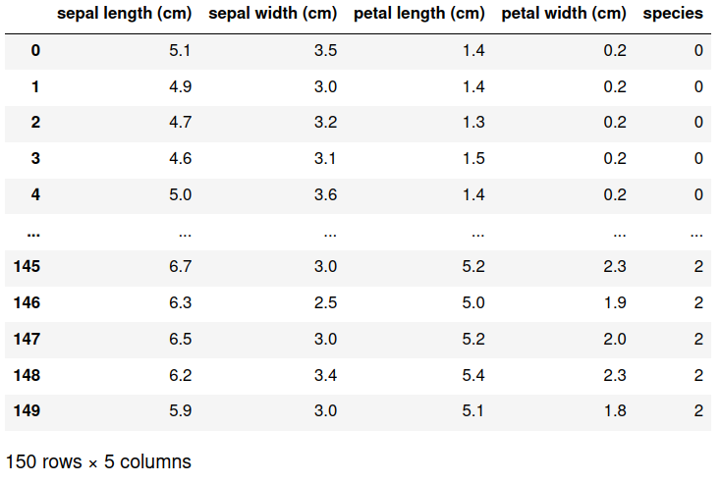
Notes:
To demonstrate the technique, we will use the iris dataset. This dataset consists of measurement of the lengths and widths of the petals and sepals of 150 iris flowers. You can see here the data in a pandas dataframe. There are 5 columns: the sepal length, sepal width, petal length, petal width, and finally, the species of iris, as an integer 0, 1, or 2.

Slide 3
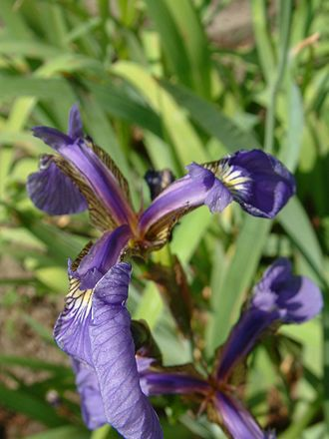
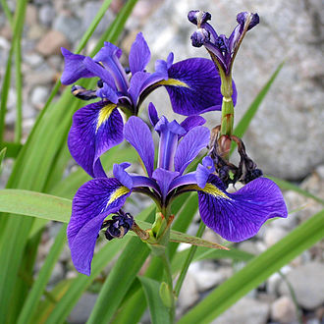
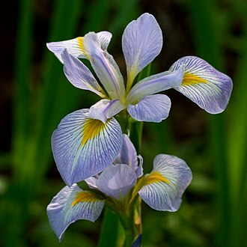
0
1
2
setosa
versicolor
virginica
https://en.wikipedia.org/wiki/Iris_setosa
https://en.wikipedia.org/wiki/Iris_versicolor
https://en.wikipedia.org/wiki/Iris_virginica
Notes:
Here a 0 stands for the species setosa, a 1 is versicolor, and a 2 is a virginica type iris.
In all of these, the sepal, which is the outer protective part of the flower, is typically wider and longer than the interior petals, which are short and narrow.
Our goal will be to build a model that can classify iris flowers into setosa, versicolor, and virginica, given the sizes of their sepals and petals.

Slide 4
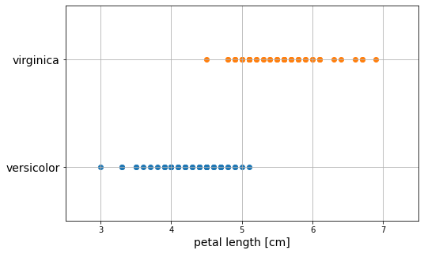
Notes:
Let's begin with a simpler problem. Let's see if we can distinguish between virginica and versicolor by their petal length alone. In this plot we see that virginica petals are typically larger than versicolor,

Slide 5
versicolor
virginica
Notes:
and so we might imagine placing a threshold about here at 4.9 cm, and declaring that all flowers with petals larger than that number are classified as virginica, and all smaller are versicolor. Sounds good. Now all we need is a methodology for computing this threshold.

Slide 6
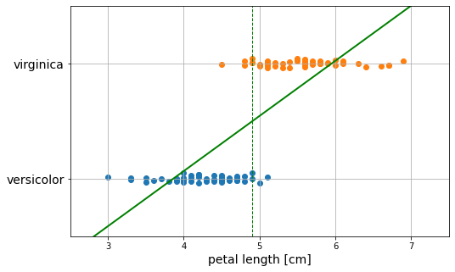

4.90
Notes:
Let's try using what we know, which is linear regression. That is, let's find a straight line that minimizes the sum of the squares of the vertical distances from the line to the data.
Then, wherever that line crosses the midpoint between versicolor and virginica, that is where we will place our threshold.
And here is the result. The linear regression line defines a threshold of 4.90 cm.

Slide 7
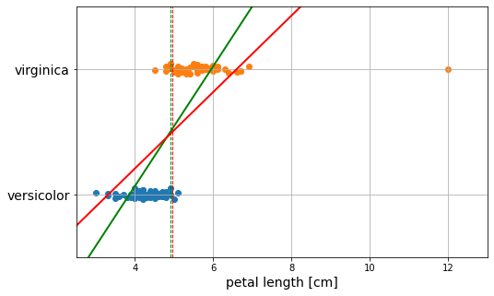
4.90
4.96
Notes:
This worked well, but what if now we add an outlier flower to the dataset. If we repeat the computation we get a new threshold of 4.96 which is not too dissimilar from 4.90. But notice also how much the regression line was affected from the green line without the outlier to the red line with the outlier.
In other words, the linear regression model is sensitive to outliers.
Logistic regression avoids the problem of sensitivity that we just witnessed with linear regression. Indeed, in this case, the sensitivity of the decision threshold due to the addition of an outlier is one million times smaller with logistic regression than with linear regression. But logistic regression also has another significant advantage which is that it produces a class membership probability instead of a bare decision threshold. We will see how these probabilities can be used to build classification models for more than two categories of objects.

